Slide 1

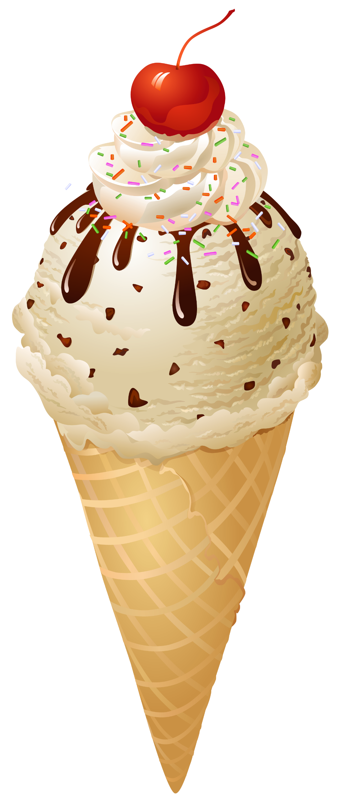
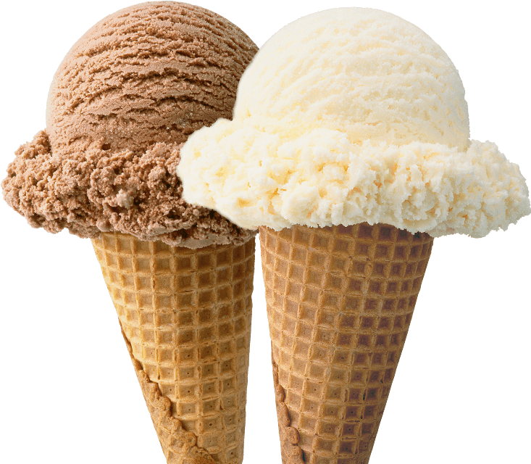
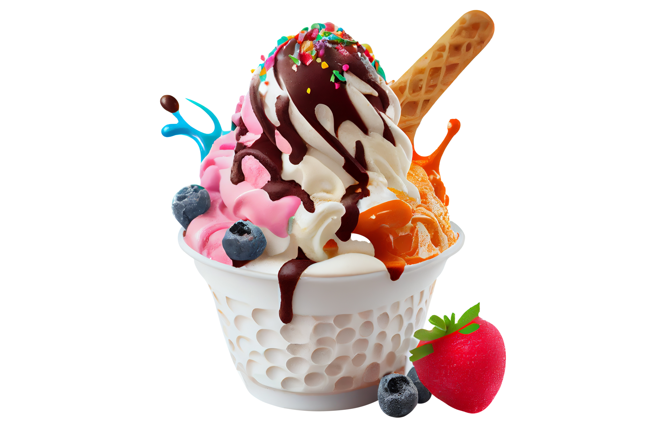
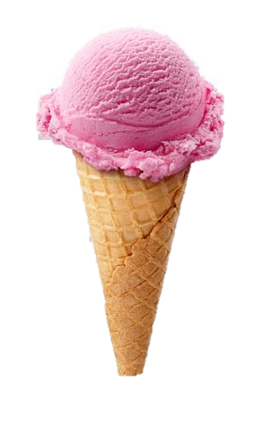
ICE CREAM
Ice cream is a frozen dessert typically made from milk or cream that has been flavoured with a sweetener, either sugar or an alternative, and a spice, such a cocoa or vanilla, or with fruit, such as strawberries or peaches. Food colouring is something added in addition to stabilizers.

Slide 2
ICE CREAM
Ice cream is a frozen dessert typically made from milk or cream that has been flavoured with a sweetener, either sugar or an alternative, and a spice, such a cocoa or vanilla, or with fruit, such as strawberries or peaches. Food colouring is something added in addition to stabilizers.

Slide 3
ICE CREAM
Ice cream is a frozen dessert typically made from milk or cream that has been flavoured with a sweetener, either sugar or an alternative, and a spice, such a cocoa or vanilla, or with fruit, such as strawberries or peaches. Food colouring is something added in addition to stabilizers.

Slide 4
ICE CREAM
Ice cream is a frozen dessert typically made from milk or cream that has been flavoured with a sweetener, either sugar or an alternative, and a spice, such a cocoa or vanilla, or with fruit, such as strawberries or peaches. Food colouring is something added in addition to stabilizers.

